Slide 1
Machine Learning in Business Financial Innovation, 3rd Edition
Chapter 5: Supervised Learning: SVMs

Slide 2
A Baby Example (We carry out an approximate scaling by subtracting 620 from the credit score) Table 5.1
Credit score | Adjusted credit score | Income (‘000s) | Default =0; good loan=1
660 | 40 | 30 | 0
650 | 30 | 55 | 0
650 | 30 | 63 | 0
700 | 80 | 35 | 0
720 | 100 | 28 | 0
650 | 30 | 140 | 1
650 | 30 | 100 | 1
710 | 90 | 95 | 1
740 | 120 | 64 | 1
770 | 150 | 63 | 1

Slide 3
Linear Separation (circles are defaulting loans, squares are good loans) Figure 5.1

Slide 4
SVM Approach
In the support vector machine (SVM) approach we find a pathway to separate the data into two classes
In the “hard margin” case perfect separation is possible (as in our example)
The algorithm finds the widest path possible (to maximize the benefits from regularization)
Data must be normalized. (We carry out approximate normalization by subtracting 620 from credit score)
The support vectors are the observations at the edge of the pathway

Slide 5
Best pathway for example. Solid line would be used to distinguish good and bad loans

Slide 6
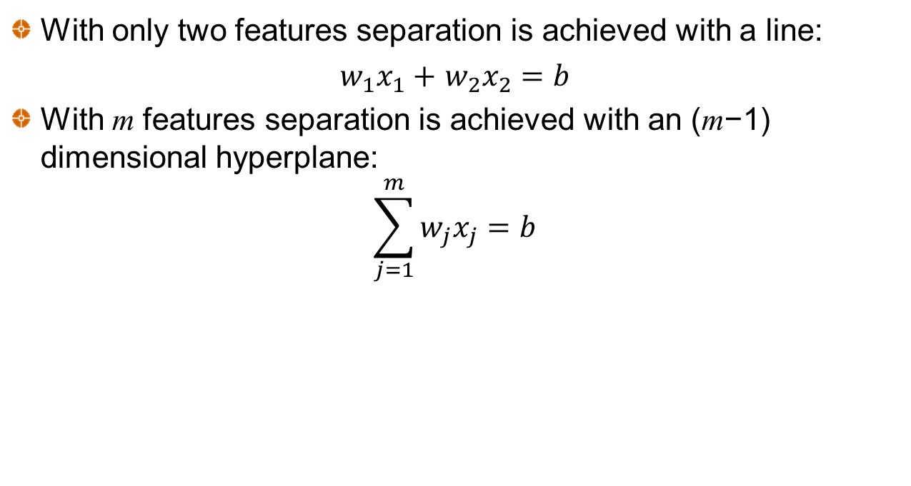
The Separating hyperplane
With only two features separation is achieved with a line:
$w_{1}x_{1}+$ $w_{2}x_{2}=b$
With m features separation is achieved with an (m−1) dimensional hyperplane:
$$\sum_{j=1}^{m}{w_{j}x_{j}=b}$$

Slide 7
Regularization
Regularization involves reducing the magnitude of the weights, w_{j}
This avoids overfitting where a there are two correlated variables one with a large positive weight and the other with a large negative weight
We minimize the sum of the squares of the weights. This is the same as maximizing the width of the pathway

Slide 8
Notation (Figure 5.3)

Slide 9
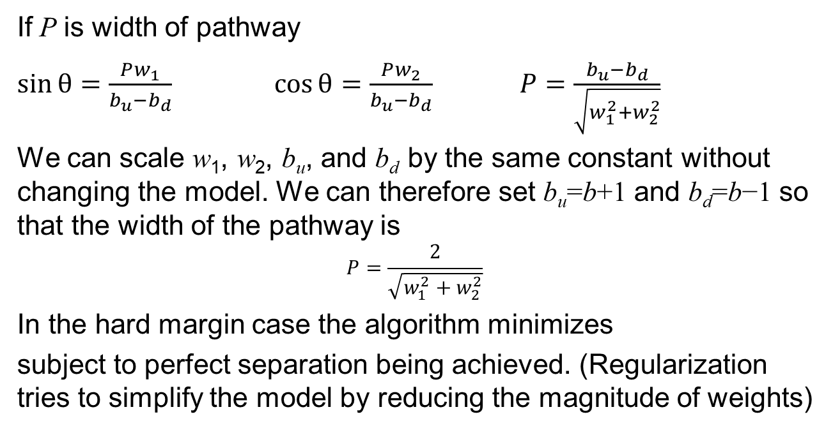
The Math
If P is width of pathway
$\sin{θ}=\frac{Pw_{1}}{b_{u}−b_{d}}$ $\cos{θ}=\frac{Pw_{2}}{b_{u}−b_{d}}$ $P=\frac{b_{u}−b_{d}}{\sqrt{w_{1}^{2}+w_{2}^{2}}}$
We can scale w₁, w₂, b_{u}, and b_{d} by the same constant without changing the model. We can therefore set b_{u}=b+1 and b_{d}=b−1 so that the width of the pathway is
$$P=\frac{2}{\sqrt{w_{1}^{2}+w_{2}^{2}}}$$
In the hard margin case the algorithm minimizes
subject to perfect separation being achieved. (Regularization tries to simplify the model by reducing the magnitude of weights)

Slide 10
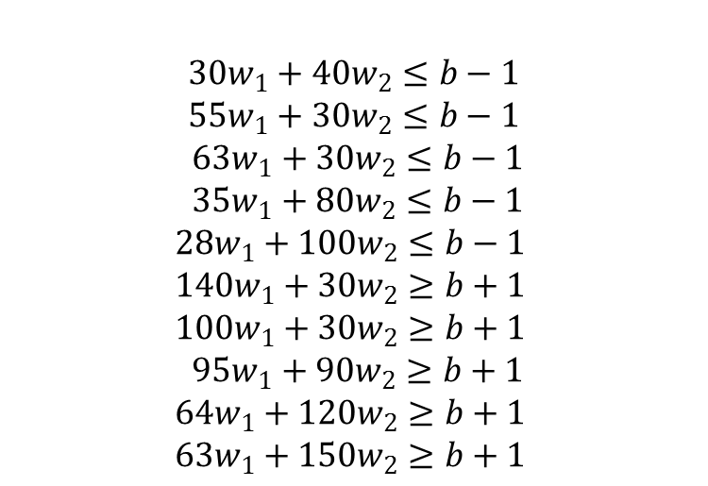
Specification of hard margin problem for baby data
In our example the task is to find b, w₁, and w₂ to minimize
subject to
$$30w_{1}+40w_{2}≤b−1$$
$$55w_{1}+30w_{2}≤b−1$$
$$63w_{1}+30w_{2}≤b−1$$
$$35w_{1}+80w_{2}≤b−1$$
$$28w_{1}+100w_{2}≤b−1$$
$$140w_{1}+30w_{2}≥b+1$$
$$100w_{1}+30w_{2}≥b+1$$
$$95w_{1}+90w_{2}≥b+1$$
$$64w_{1}+120w_{2}≥b+1$$
$$63w_{1}+150w_{2}≥b+1$$

Slide 11
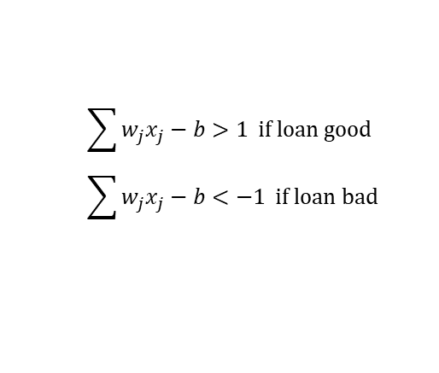
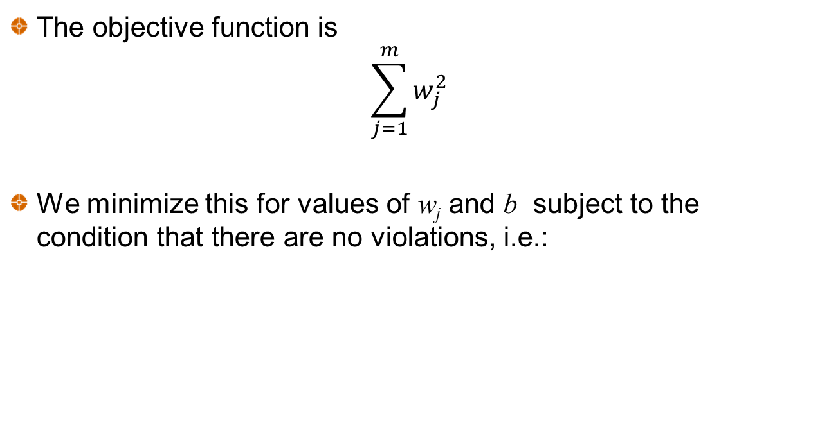
The general hard margin problem
The objective function is
$$\sum_{j=1}^{m}{w_{j}^{2}}$$
We minimize this for values of w_{j} and b subject to the condition that there are no violations, i.e.:
$$\sum{w_{j}x_{j}−b>1} \text{if} \text{loan} \text{good} \\ \sum{w_{j}x_{j}−b<−1} \text{if} \text{loan} \text{bad}$$

Slide 12
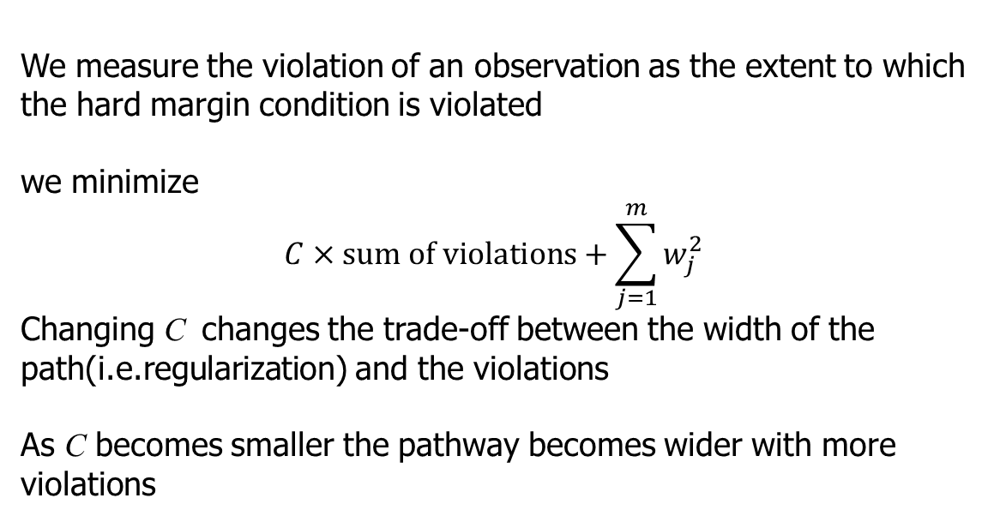
The Soft Margin Problem
We measure the violation of an observation as the extent to which the hard margin condition is violated
we minimize
$$C×sum of violations+\sum_{j=1}^{m}{w_{j}^{2}}$$
Changing C changes the trade-off between the width of the path(i.e.regularization) and the violations
As C becomes smaller the pathway becomes wider with more violations

Slide 13
Changed example:
Credit score | Adjusted credit score | Income (‘000s) | Default =0; good loan=1
660 | 40 | 30 | 0
650 | 140 | 55 | 0
650 | 30 | 63 | 0
700 | 80 | 35 | 0
720 | 100 | 28 | 0
650 | 30 | 140 | 1
650 | 30 | 100 | 1
710 | 90 | 60 | 1
740 | 120 | 64 | 1
770 | 150 | 63 | 1

Slide 14
C=0.001 Results (Figure 5.4)

Slide 15
Impact of C for Example (Table 5.3)
C | w₁ | w₂ | b | Loans mis-classified by centerline | Width of pathway | Total pathway violations
0.01 | 0.054 | 0.022 | 5.05 | 10% | 34.4 | 2.81
0.001 | 0.040 | 0.012 | 3.33 | 10% | 48.2 | 3.31
0.0005 | 0.026 | 0.010 | 2.46 | 10% | 70.6 | 4.79
0.0003 | 0.019 | 0.006 | 1.79 | 20% | 102.2 | 5.79
0.0002 | 0.018 | 0.003 | 1.69 | 30% | 106.6 | 5.91

Slide 16
Non-linear separation (Figure 5.5)

Slide 17
Non-linear classification
The objective is to create new features so that the boundary becomes linear
Suppose there is a single feature (age?) and we find the low and high values of the feature tend to give one outcome while intermediate values give another outcome
We could form a new feature as (v-m)² where v is the feature value and m is its mean

Slide 18
Forming new features
We can add powers of each feature as a new feature.
Alternatively, we can choose particular landmarks and create new features using the Gaussian Radial Basis Function (a similarity function). If values of features at a landmark are ℓ₁, ℓ_{2,} ……, ℓ_{m}, the new feature values are calculated as
As the parameter γ increases the span of influence of a landmark decreases and the boundary becomes less smooth

Slide 19
SVM Regression: using SVM to predict a continuous variable
We search for a pathway with a certain width that includes as many target values as possible
If a target value lies within the pathway there is assumed to be no error
If it lies outside the pathway the error is the difference between the actual value and the value predicted by the outer edge of the pathway

Slide 20
The Single Feature Case
Observation
Error

Slide 21
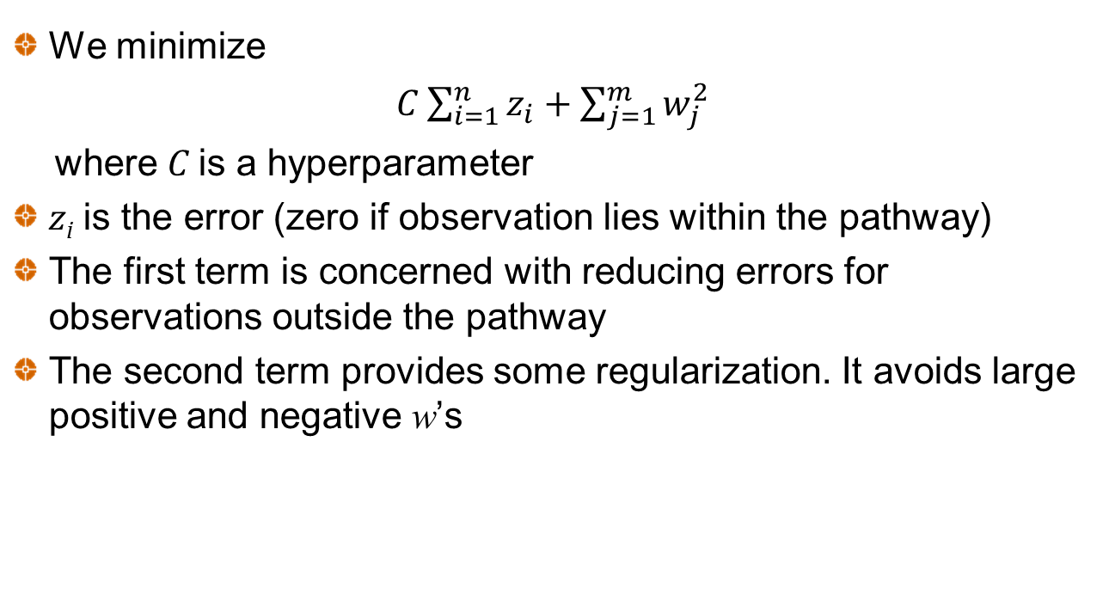
General Case
We minimize
$C\sum_{i=1}^{n}{z_{i}}+\sum_{j=1}^{m}{w_{j}^{2}}$
where C is a hyperparameter
z_{i} is the error (zero if observation lies within the pathway)
The first term is concerned with reducing errors for observations outside the pathway
The second term provides some regularization. It avoids large positive and negative w’s

Slide 22
Predicting Iowa House Prices from Living Area when e=50,000 and C=0.01 (Figure 5.7)

Slide 23
Predicting Iowa House Prices from Living Area when e=100,000 and C=0.1 (Figure 5.8)

